Slide 1
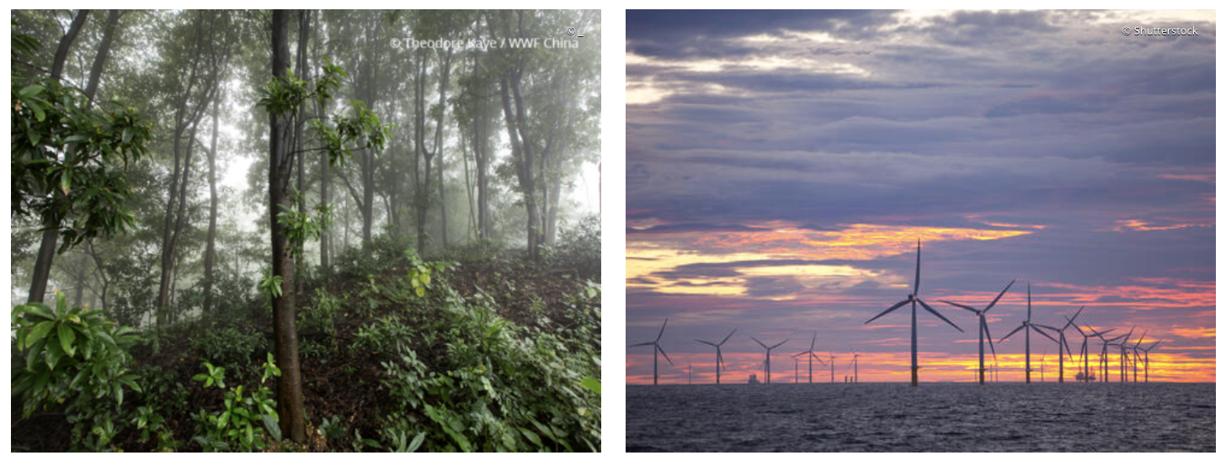
The IPCC approach: 1. Mitigation
Climate change mitigation means avoiding and reducing emissions of heat-trapping greenhouse gases into the atmosphere to prevent the planet from warming to more extreme temperatures.
Transition from powering our world with fossil fuels to using clean, renewable energy.
Stop deforestation and restore our natural habitats until we reach net-zero carbon emissions—meaning that the release of greenhouse gases into the atmosphere is balanced with the capture and storage of those gases in places like tree roots.

Slide 2
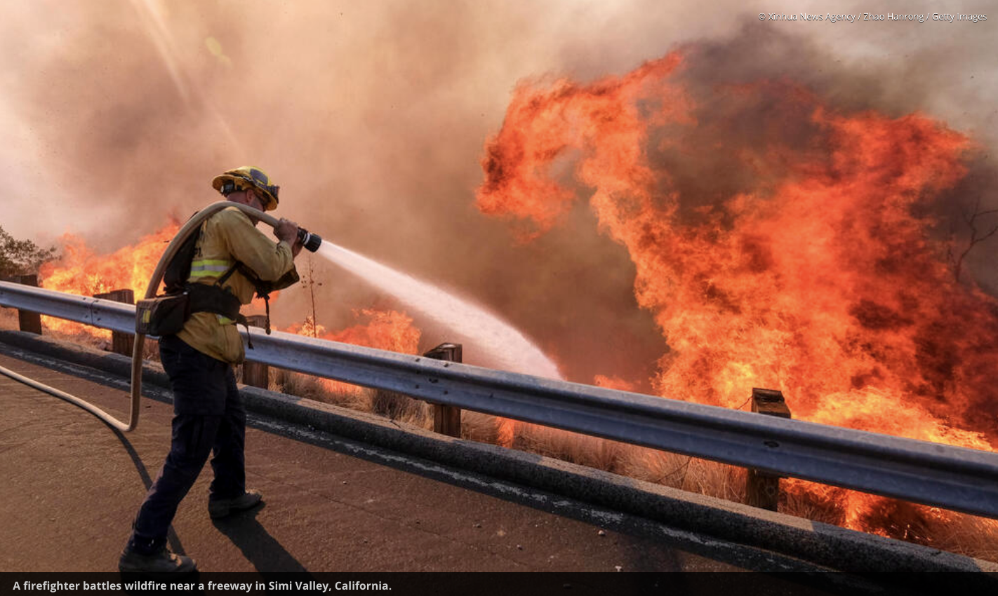
The IPCC approach: 2. Adaptation
Climate change adaptation means altering our behavior, systems, and—in some cases—ways of life to protect our families, our economies, and the environment in which we live from the impacts of climate change. The more we reduce emissions right now, the easier it will be to adapt to the changes we can no longer avoid.
Examples …
Diversifying crops that can tolerate warmer and drier or wetter conditions
Ensuring infrastructure can withstand more extreme weather
Helping communities reduce their risk from sea level rise and increased floods
Making sure we manage our food, water, and other natural resources wisely in the context of a changing climate.

